Slide 1





Unlocking Host Success: Data-Driven Insights for Airbnb
Unveiling the Traits of High-Performing Hosts to Fuel Platform Growth and Secure Investment Business Case Study by Rohit Singh

Slide 2
Introduction - Empowering Hosts, Fueling Growth
At Airbnb, we are poised to maximize the potential of our platform by empowering our hosts.
Airbnb, a dynamic home-sharing marketplace, seamlessly connects travelers with distinctive accommodations curated by local residents.
However, to optimize growth, it is imperative to foster host success. Therefore, we have initiated a rigorous data-driven initiative aimed at delineating the pivotal attributes and strategies that define an accomplished Airbnb host.
By comprehending these defining traits, we can tailor targeted support and resources, fostering the prosperity of our hosts and catalyzing the expansion of our platform.

Slide 3
The Challenge: Data-Backed Evidence for Host Success
Problem:
Airbnb's expansion into new cities requires a nationwide marketing campaign aimed at potential and current hosts.
Investors and venture capitalists (VCs) seek data-driven evidence of successful host traits specific to Airbnb to support campaign funding.
Tasks Performed:
Analyzed key data points including host demographics, location, and listing performance metrics (e.g., Review Scores Location and Value, Amenities, Cancellation policy, Reviews).
Examined revenue generation metrics such as Revenue Per Day and Pseudo-Revenue.
Conducted Exploratory Data Analysis (EDA) on Airbnb host and listing data to uncover insights.
Identified potential relationships between host traits and listing success.
Visualized data to enhance clarity and comprehension.
Developed data-based recommendations. The subsequent slides will unveil the key insights garnered from our analysis, informing a data-driven marketing strategy to target the most suitable hosts and propel Airbnb's growth.

Slide 4
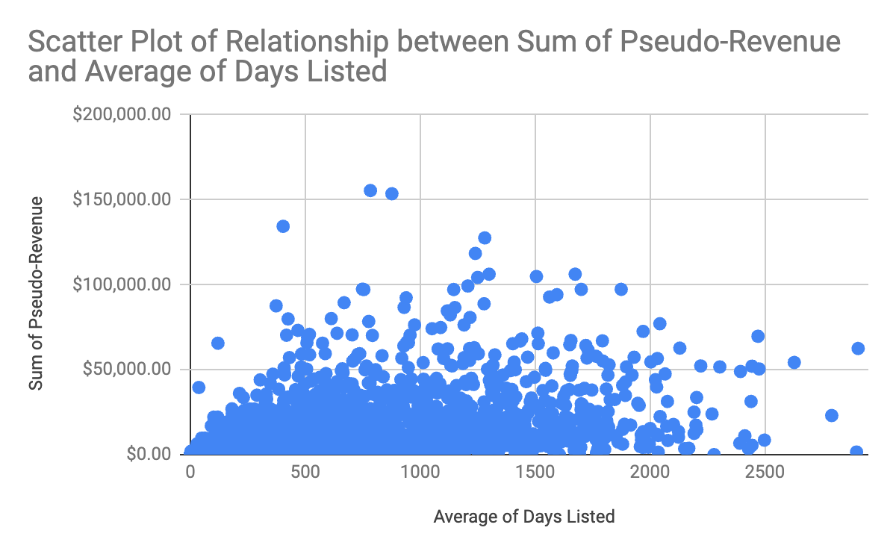
Hosts could experiment with extending their listing durations!
Key Insights:
Listings with longer average durations tend to generate higher total revenue over time.
Longer active periods increase visibility to potential guests, translating into more bookings and increased revenue.
Recommendation:
Hosts are encouraged to experiment with extending their listing durations to maximize exposure and bookings.
Longer listing durations can lead to increased exposure, bookings, and revenue for hosts.
Impact: Enhancing listing durations benefits both hosts and Airbnb by expanding the platform's active inventory, fostering growth and revenue.
The scatter plot shows a positive correlation between the average number of days a listing is active and the sum of pseudo-revenue generated by that listing.

Slide 5
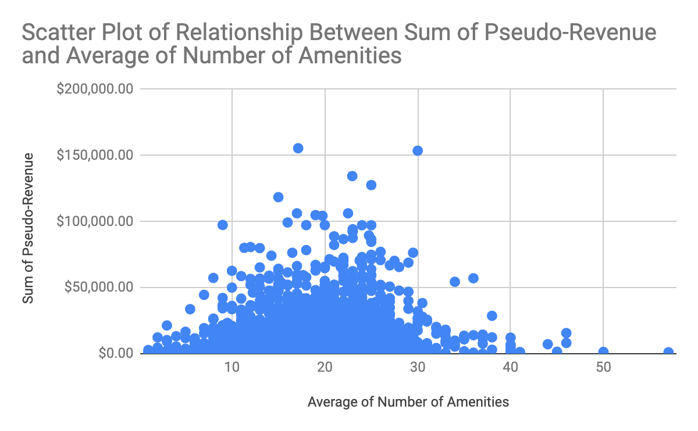
Hosts should carefully evaluate the cost and effort involved in adding amenities!
Key Insight: Listings with a moderate number of relevant amenities tend to attract a broader range of guests.
Guest Preferences:
Core amenities such as wifi and laundry facilities are prioritized by guests.
Beyond essential amenities, additional offerings may have diminishing impact on guest decisions.
Recommendation: Hosts should carefully curate amenities to enhance guest experience without incurring unnecessary expenses. Focus on providing a relevant selection of amenities that maximize guest appeal and satisfaction.
Impact: Optimizing amenities improves guest satisfaction and appeal, optimizing the host's investment in enhancing the guest experience.
The scatter plot shows a somewhat positive correlation between the average number of amenities offered by a host and the sum of pseudo-revenue generated by that listing. But, the increase in revenue seems to level off after a certain point, suggesting diminishing returns.

Slide 6
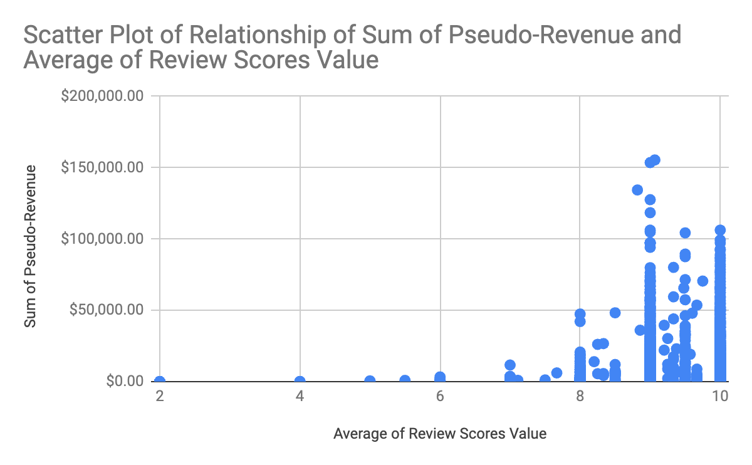
Focusing solely on maximizing review scores may not be the most
effective strategy for all hosts!
Key Insight:Exceeding baseline review score expectations can enhance trust and reliability, leading to increased bookings and revenue.
Guest Expectations:Once baseline expectations are met, further score improvements may have diminishing impact on guest decisions.
Recommendation:
Hosts should explore a range of listing optimization techniques beyond review scores.
Strategies may include high-quality photos, detailed descriptions, unique features, & competitive rates.
Benefit: Diversifying optimization strategies attracts a broader guest audience and potentially increases revenue without sole reliance on review scores.
There's a somewhat positive correlation between the average review score and the sum of pseudo-revenue generated by the listing. Listings with higher average review scores tend to have higher total revenue. But, the data points seem to cluster more densely in a specific range of high review scores.

Slide 7
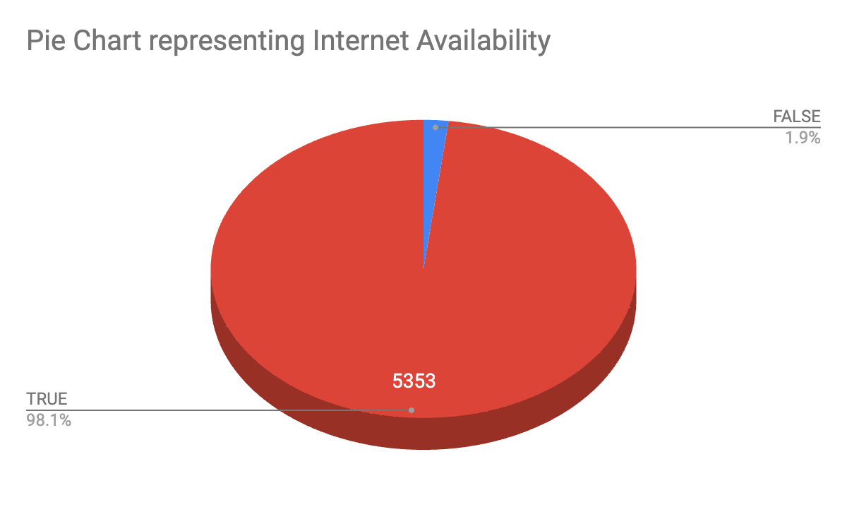
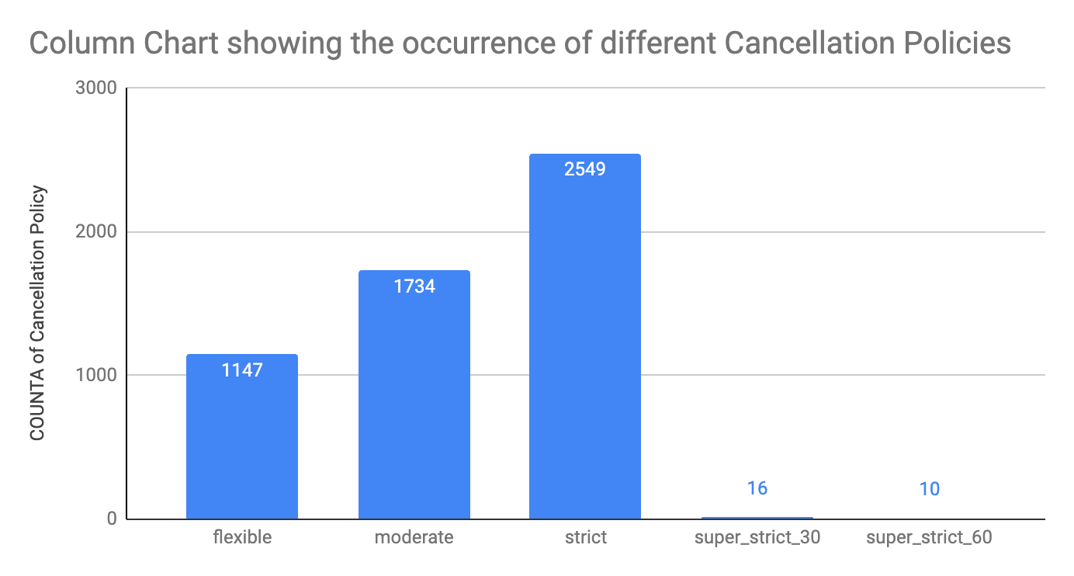
Some additional data driven recommendations
Target Guests Needing Reliable Internet!
Tailor Policies to Target Audience
Highlight internet availability in the listing description, especially if it's a standard expectation in the local market.
Attract guests by emphasizing this essential amenity.
Hosts with stricter cancellation policies can emphasize trustworthiness and reliability.
Appeal to guests seeking predictability and peace of mind with tailored policies.
Impact: Implementing these recommendations enhances listing visibility and appeal, catering to specific guest needs & preferences.

Slide 8
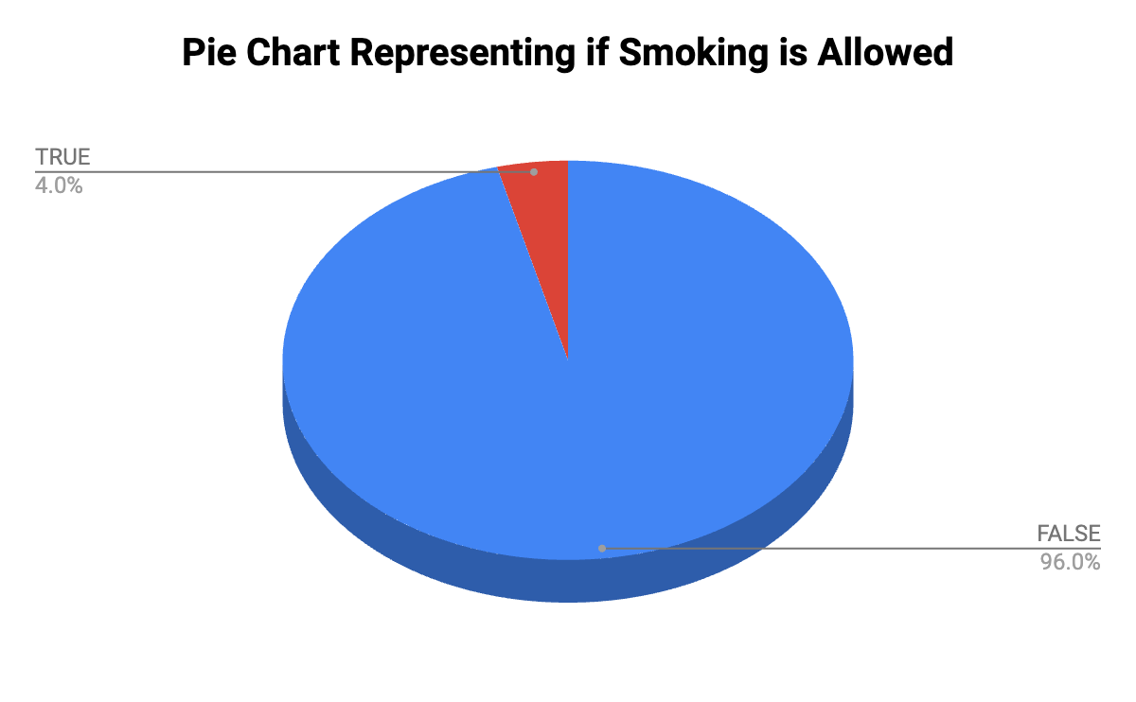
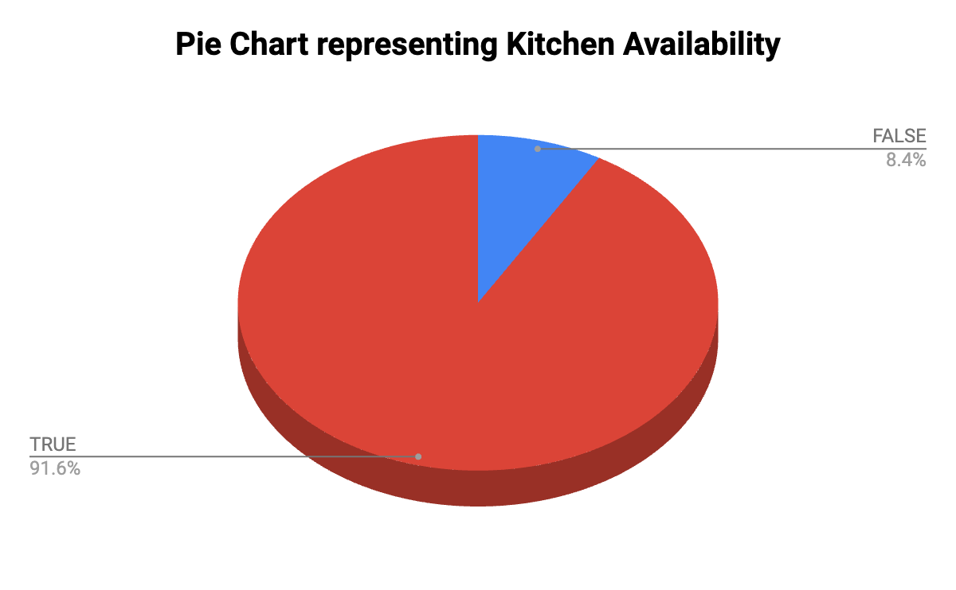
Some additional data driven recommendations
Establishing Clear Smoking Policies
Highlighting Kitchen Availability
Clearly communicate a no-smoking policy to manage guest expectations and prevent smoke odor issues.
If smoking is allowed, create specific outdoor smoking areas with provided ashtrays.
Clearly state your smoking policy in the listing description and use signage to reinforce rules.
Clearly mention the availability of a kitchen in your listing description and amenities list.
Include high-quality photos of your kitchen to showcase functionality and amenities.
Consider including essential kitchen supplies (e.g., pots, pans, utensils, dishes) for guest convenience.
Ensure the kitchen is clean, well-maintained, and all appliances are in good working order.

Slide 9
Learnings for Host Success with Data-Driven Strategies
Key Points:
Providing data-driven resources to optimize listings and maximize revenue empowers hosts.
Attracting and retaining successful hosts drives bookings and platform expansion, fueling growth.
Differentiating Airbnb through a data-driven approach to host success secures a competitive advantage in the market.
Partnering with us means investing in the future of Airbnb and the success of our vibrant host community.
Benefits:
Hosts benefit from enhanced support and insights, leading to improved performance and guest satisfaction.
Airbnb gains a competitive edge by leveraging data-driven strategies to elevate host success and platform growth.

